Slide 1
Cost Allocation Introduction July 2025

Slide 2
Overview
Flexera CCO has two constructs for categorizing cloud costs:
Dimensions - These function like virtual tags. Each cost ingested into the platform will have a value for each dimension. Many dimensions are built-in, but custom dimensions can be added as well.
Examples: Cloud Vendor Account, Service, Machine Type
Billing Centers - These exist in a hierarchy and are intended to sort costs into buckets of ownership. They are primarily used for chargeback/showback. There are no built-in Billing Centers; they are always created from scratch to represent the user’s business structure.
Examples: CIO, Finance, App Team, etc.

Slide 3
Dimensions

Slide 4
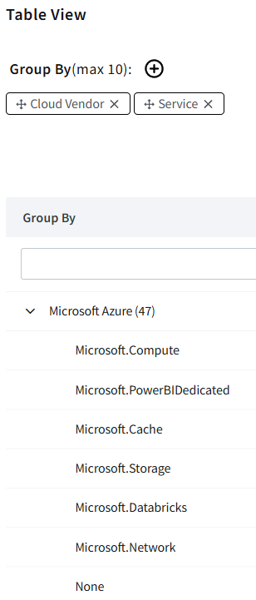
Dimensions
Dimensions function like virtual tags; each dimension name is like a tag key and has a single value for each cost in the Flexera platform.
When a dimension has no value set for a specific cost, it will have a value of “None”.
Dimensions are primarily used to aggregate costs in various ways for analysis. For example, I can easily track spend over time for the Microsoft.Storage service by using the Service dimension.

Slide 5
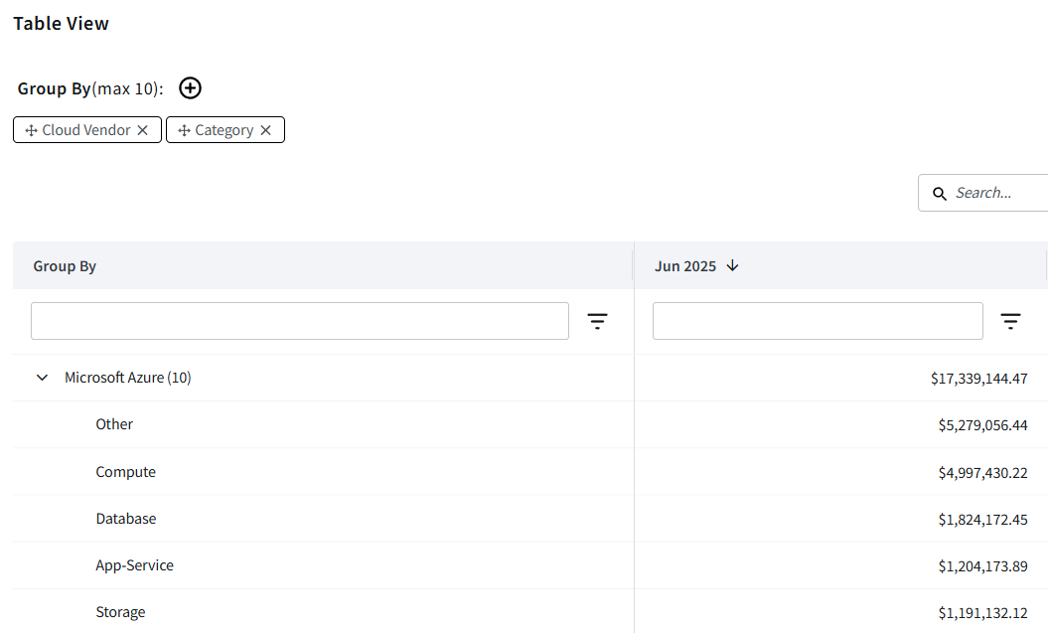
Dimensions: Tabular View Example

Slide 6
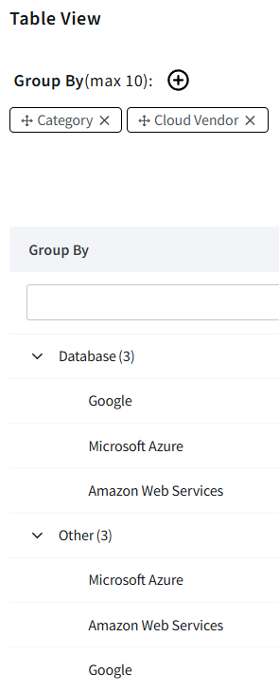
Built-In Dimensions
Many dimensions are built into the Flexera One platform and become available immediately upon ingesting cloud bill data.
These dimensions have values that are inferred from the billing data itself and do not need to reference any external sources of information.
Some built-in dimensions, such as Category, are intended to generalize costs across different cloud vendors to allow broader analysis.

Slide 7
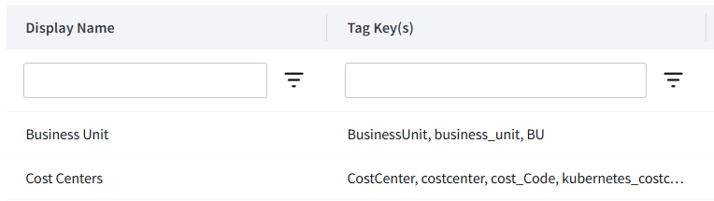
Custom Dimensions: Tag Dimensions
Tag Dimensions are custom dimensions the user can create.
Tag Dimensions aggregate the values of various resource tag keys to represent them in the Flexera One platform. Resource tag values are pulled from the ingested billing data and are not real time.
This allows users to overcome poor tagging hygiene by consolidating similar tag keys into a single dimension in Flexera One.
Currently, only resource-level tags are supported, not account-level tags.

Slide 8
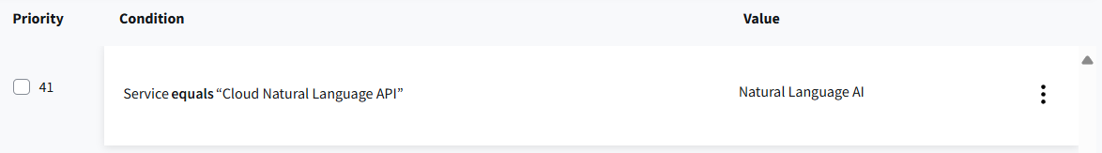
Custom Dimensions: Rule-Based Dimensions
Rule-Based Dimensions are custom dimensions the user can create.
Rule-Based Dimensions use rules to determine what the value of the dimension should be for a given cost.
Rules reference existing dimensions, which can be built-in dimensions, Tag Dimensions, or other Rule-Based Dimensions.
Rules apply top down; for each cost, the first rule whose condition statement is true will determine the value of the Rule-Based Dimension for that cost.
Rules can have a fair degree of complexity; multiple statements can be combined with AND or OR statements, and statements can be negated with NOT.

Slide 9
Billing Centers

Slide 10
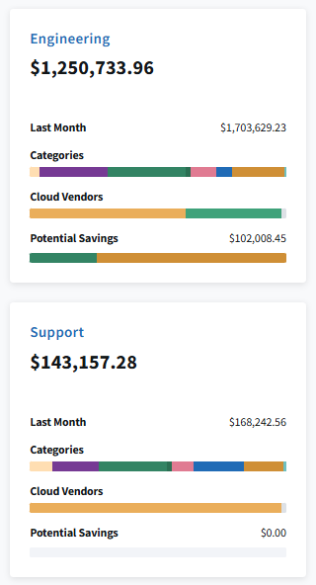
Billing Centers
Billing Centers are buckets that store costs associated with a particular business unit, department, application, etc. within an organization.
Billing Centers are hierarchical; each Billing Center can have several Billing Centers underneath it.
Costs that are not allocated to a Billing Center are automatically placed in the Unallocated Billing Center. This is the only Billing Center that exists by default and cannot be deleted or modified.

Slide 11
Billing Centers: Example Hierarchy
Engineering
Team Apple
Team Pear
Application 859644
Application 123568
Application 569875
Application 559622

Slide 12
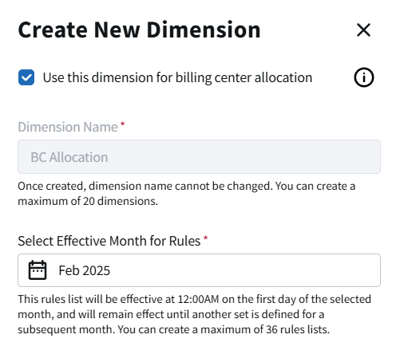
Billing Centers: Allocation
New Billing Centers, by default, will have no costs allocated to them.
Costs are allocated to Billing Centers using a special Rule-Based Dimension named “BC Allocation”.
The value of the rules for this dimension should be set to the ID of the Billing Center the costs should be allocated to.
Allocations will trickle up through the Billing Center hierarchy.

Slide 13
APIs

Slide 14
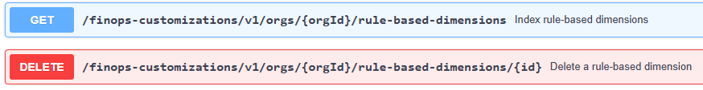
APIs
Custom dimensions and Billing Centers can be manipulated via REST APIs using a Flexera One access token.
This is useful for building automation to generate Billing Centers and Rule-Based Dimensions based on an external source of truth, such as a CMDB or database.
Documentation can be found here:
Dimensions: https://developer.flexera.com/docs/api/finops-customizations/v1
Billing Centers: https://reference.rightscale.com/billing_center/#/

Slide 15
Q&A

